Slide 1
IST 450
INFORMATION SYSTEMS DEPARTMENT WEBSITE
Esha Attiq
5/11/2025

Slide 2
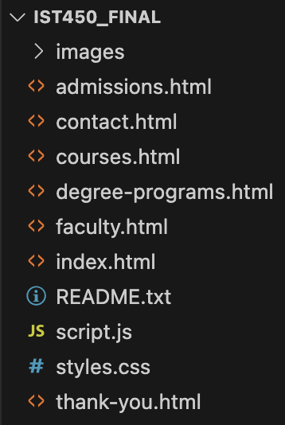
AGENDA - PROJECT NAME: IST450_FINAL
README.txt
Homepage (index.html)
Quick Links
Degree Programs (degree-programs.html)
Courses (courses.html)
Faculty (faculty.html)
Admissions (admissions.html)
Contact (contact.html)
Thank You (thank-you.html)
JavaScript
script.js
CSS
styles.css
Images folder
Please Note:
Only the Main Content will be shown for every page. The Header, Nav List, and Footer are all the SAME throughout. These are shown on the Homepage slides.
Thank you.

Slide 3
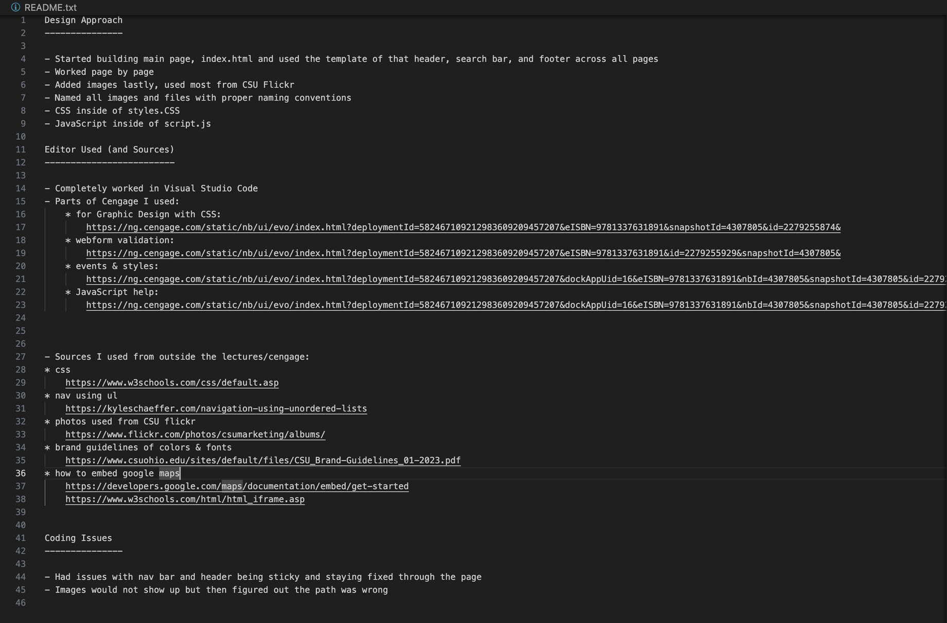
README - (README.TXT)
Includes:
Design Approach
Editor Used (and Sources)
Coding Issues

Slide 4
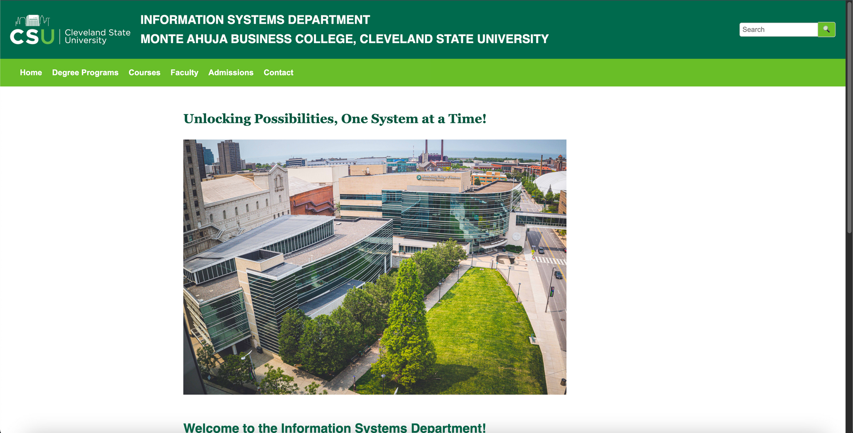
HOMEPAGE - (INDEX.HTML ) - (WEBPAGE)

Slide 5
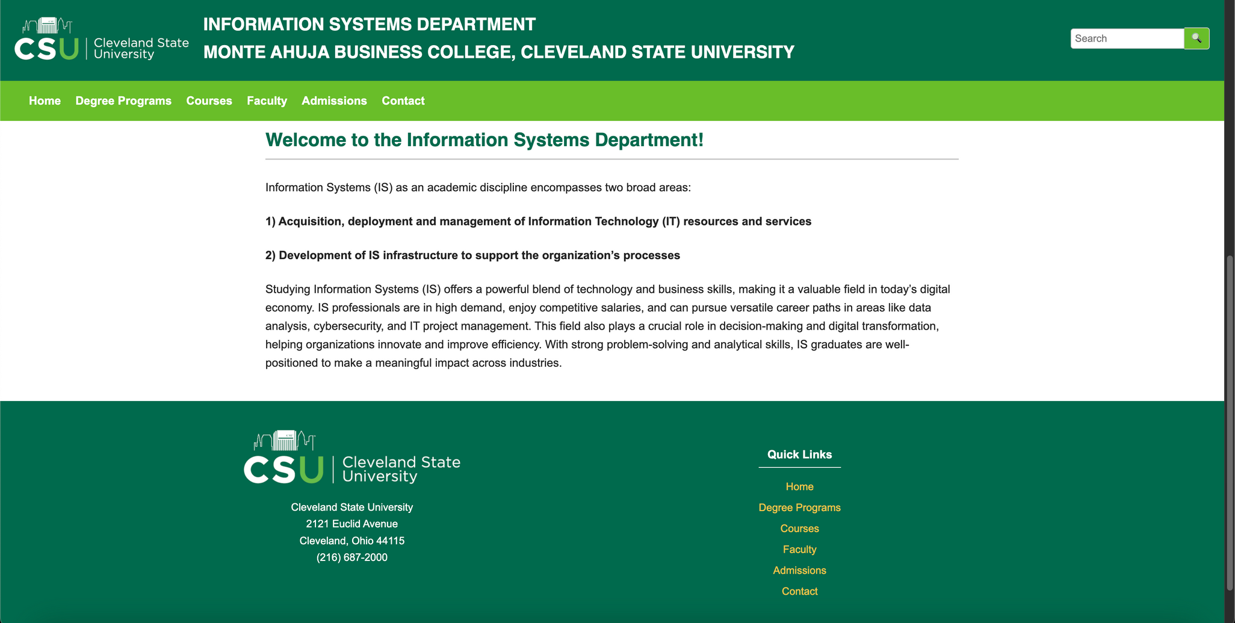

HOMEPAGE - (INDEX.HTML ) - (WEBPAGE)

Slide 6
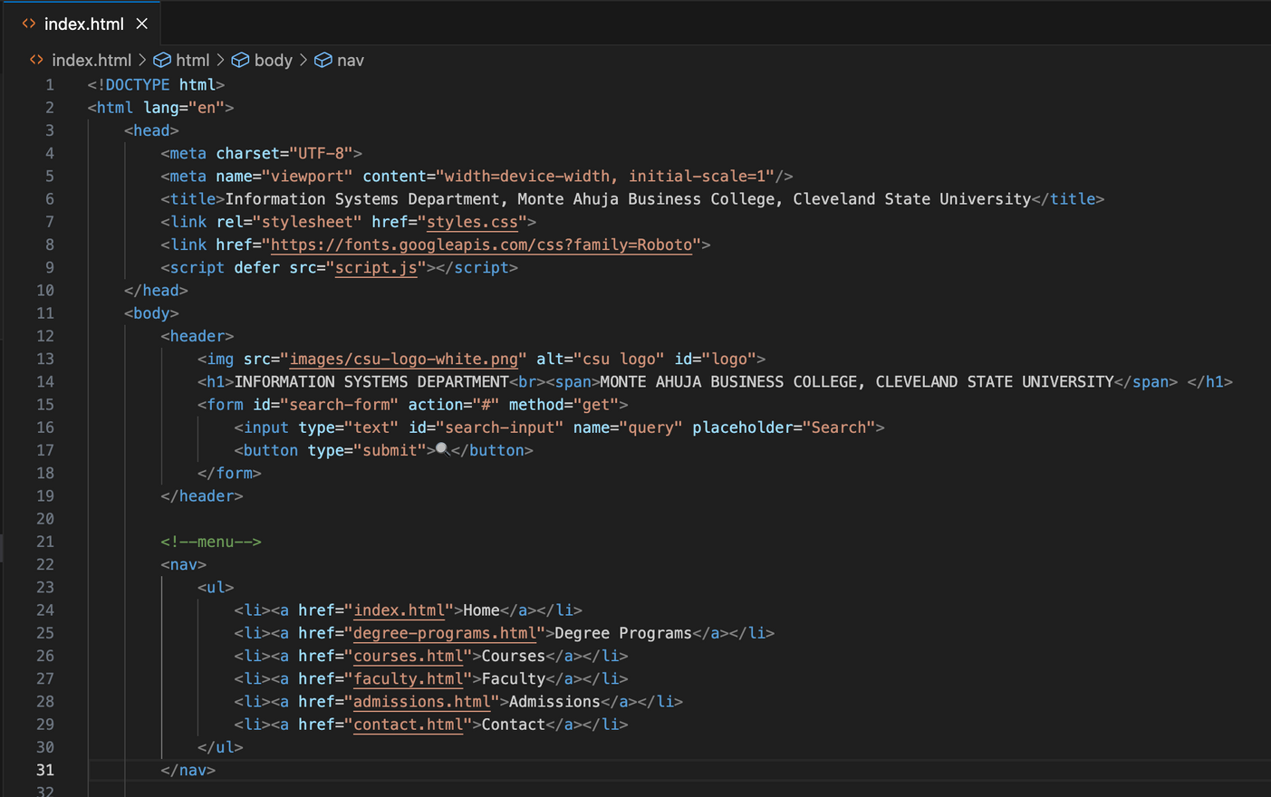
HOMEPAGE - (INDEX.HTML ) - (CODE/INFO)
Includes:
Header
Every page has this
Includes name of department, logo, search bar, along with css and js files linked
Nav list
Every page has this
Has all of the pages to be able to link to, under the header
Home, Degree Programs, Courses, Faculty, Admissions, Contact

Slide 7
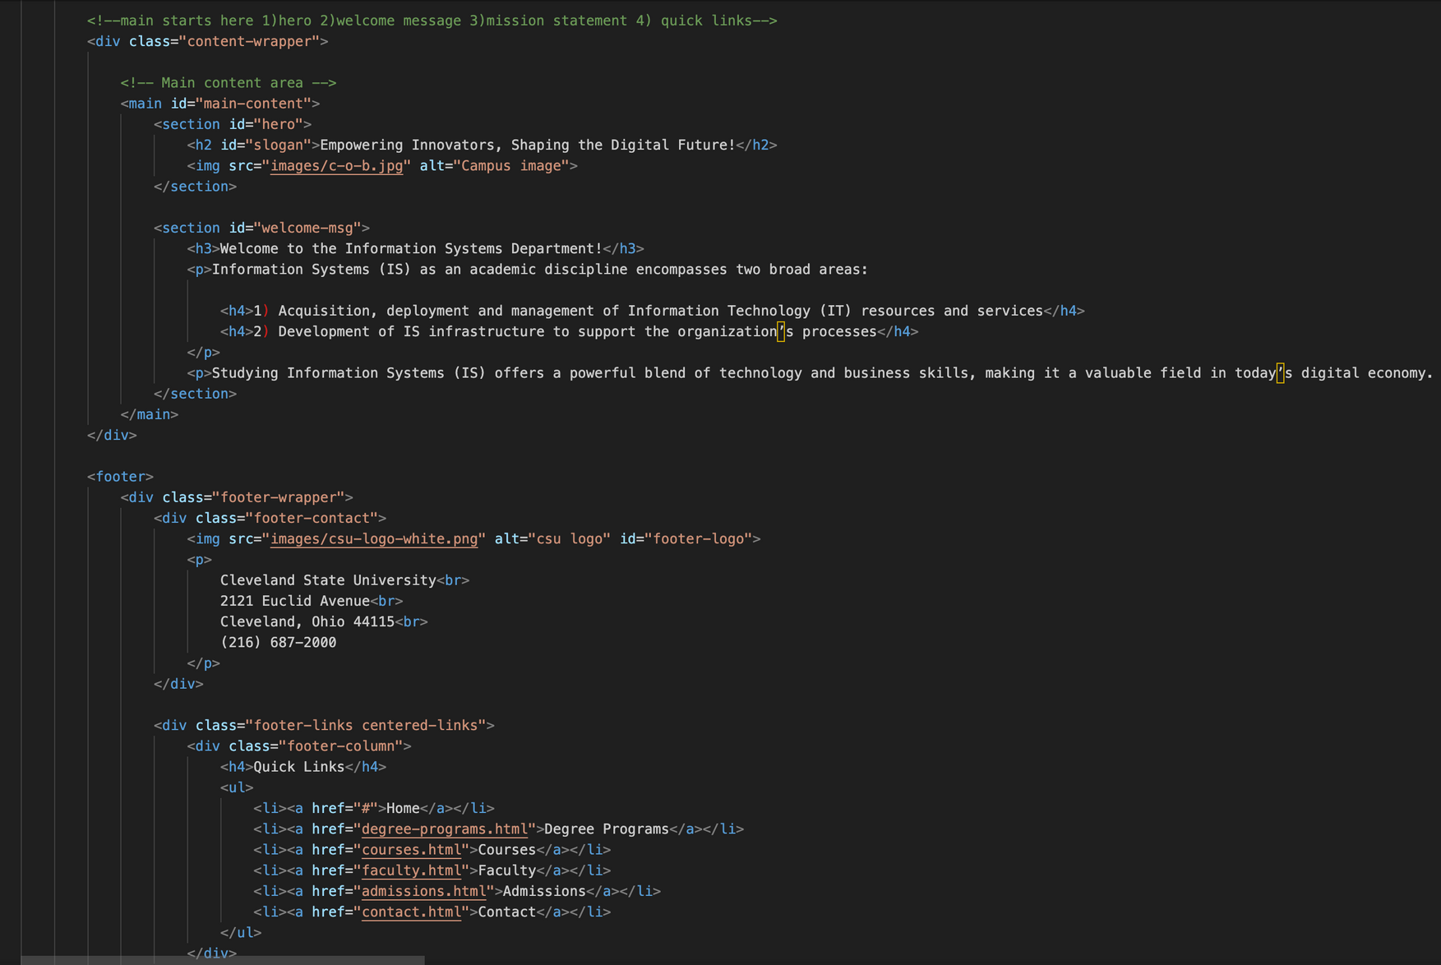
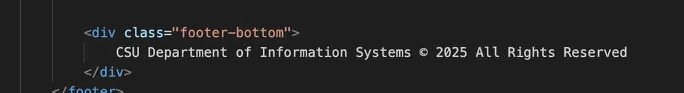
HOMEPAGE - (CONTINUED)
Main Content
Hero image
Welcome message from official CSU IS page
Footer
Every page has this at BOTTOM of page
Logo and address of CSU, copy right and name of department
Quick Links
Home, Degree Programs, Courses, Faculty, Admissions, Contact

Slide 8
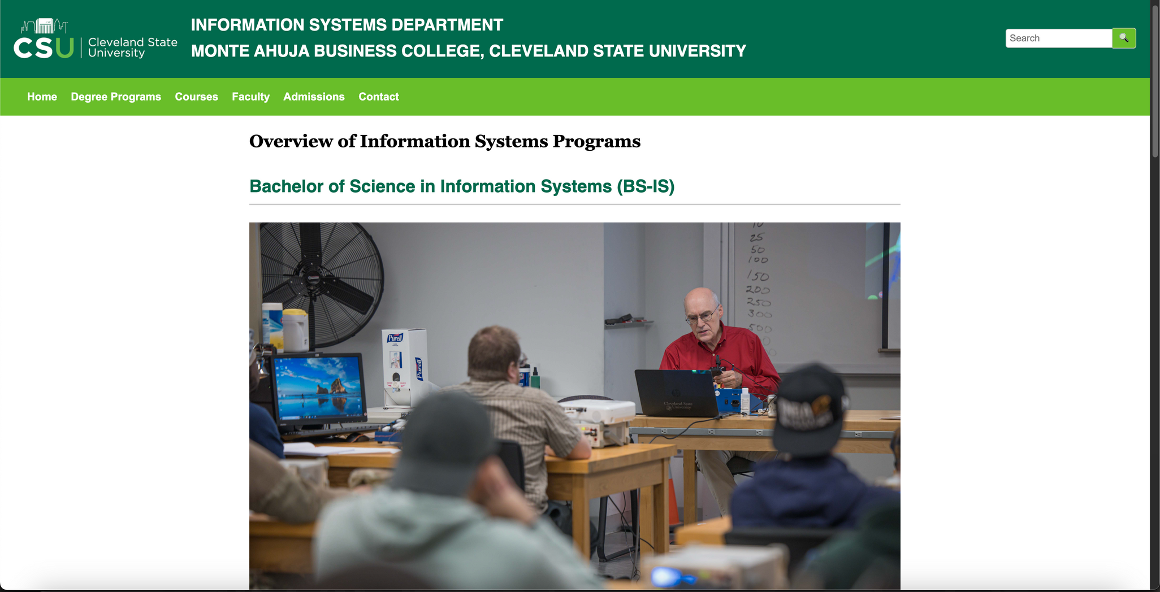
DEGREE-PROGRAMS.HTML - (WEBPAGE)

Slide 9
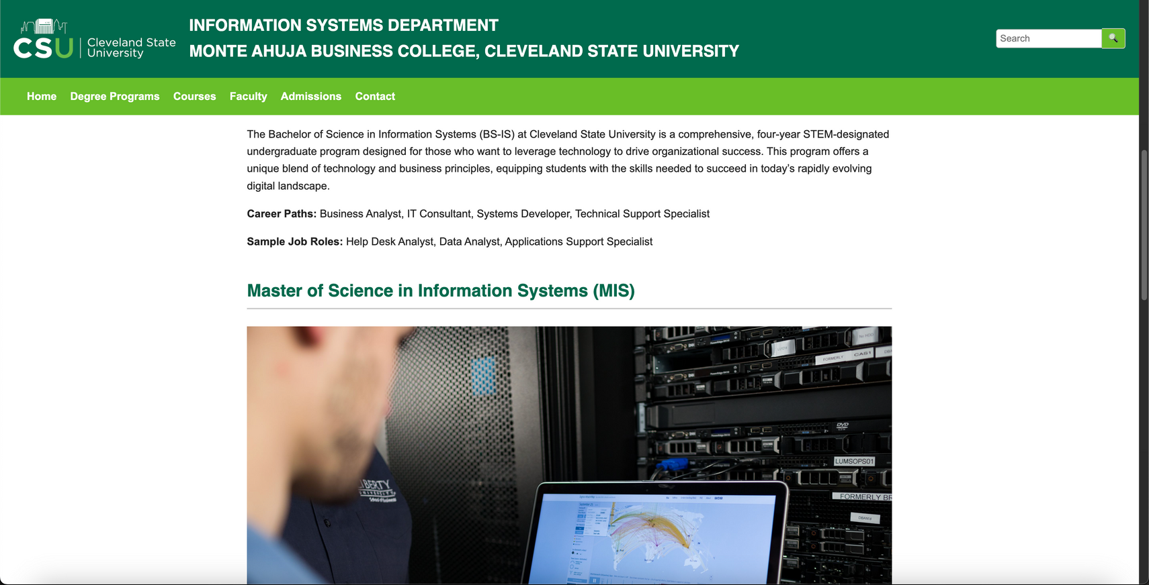
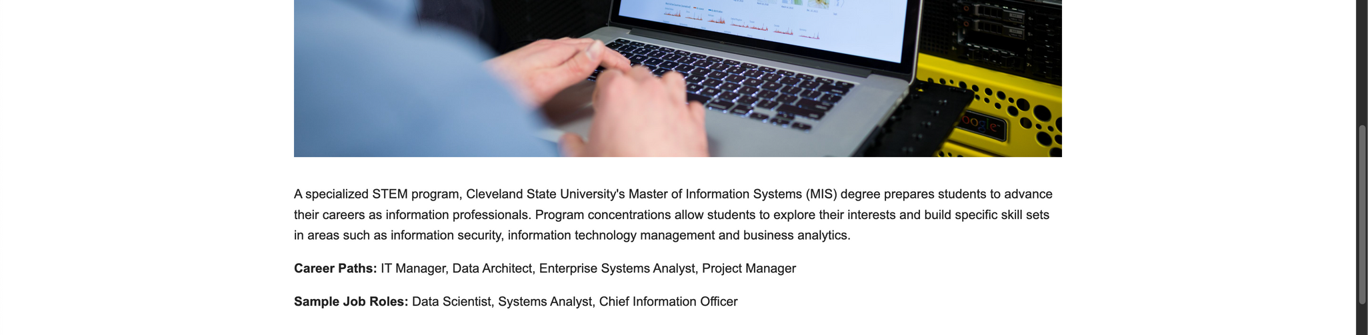
DEGREE-PROGRAMS.HTML - (WEBPAGE)

Slide 10
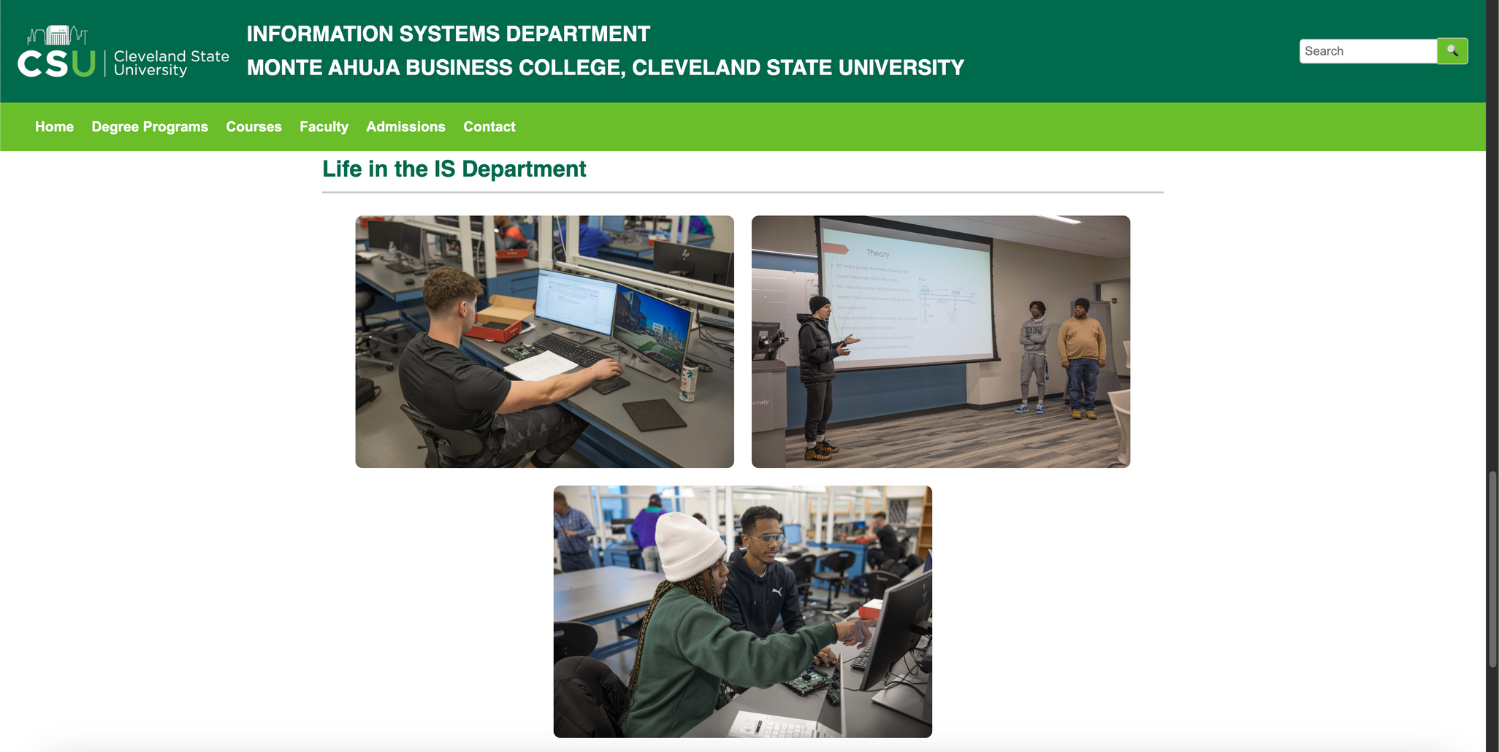

DEGREE-PROGRAMS.HTML - (WEBPAGE)

Slide 11
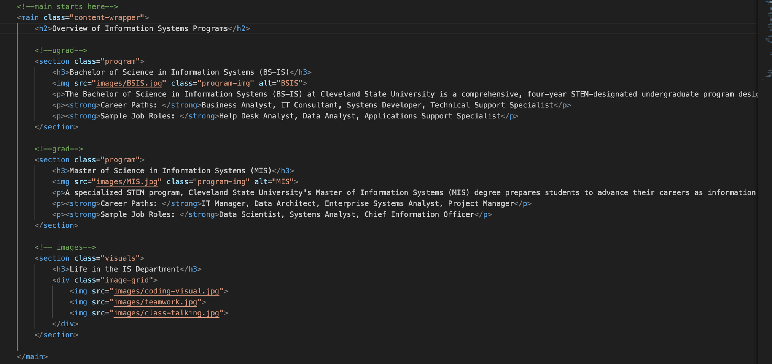
DEGREE-PROGRAMS.HTML - (CODE)

Slide 12
DEGREE-PROGRAMS.HTML - (CONTINUED)
Includes:
Header
Nav List
Main Content
Program overview for Bachelors and Masters in Information Systems
Different image for each program along with description, career paths, and sample job roles
Section for only Images to show visuals of “Life In the IS department”
Coding visual, teamwork, class talking
Footer

Slide 13
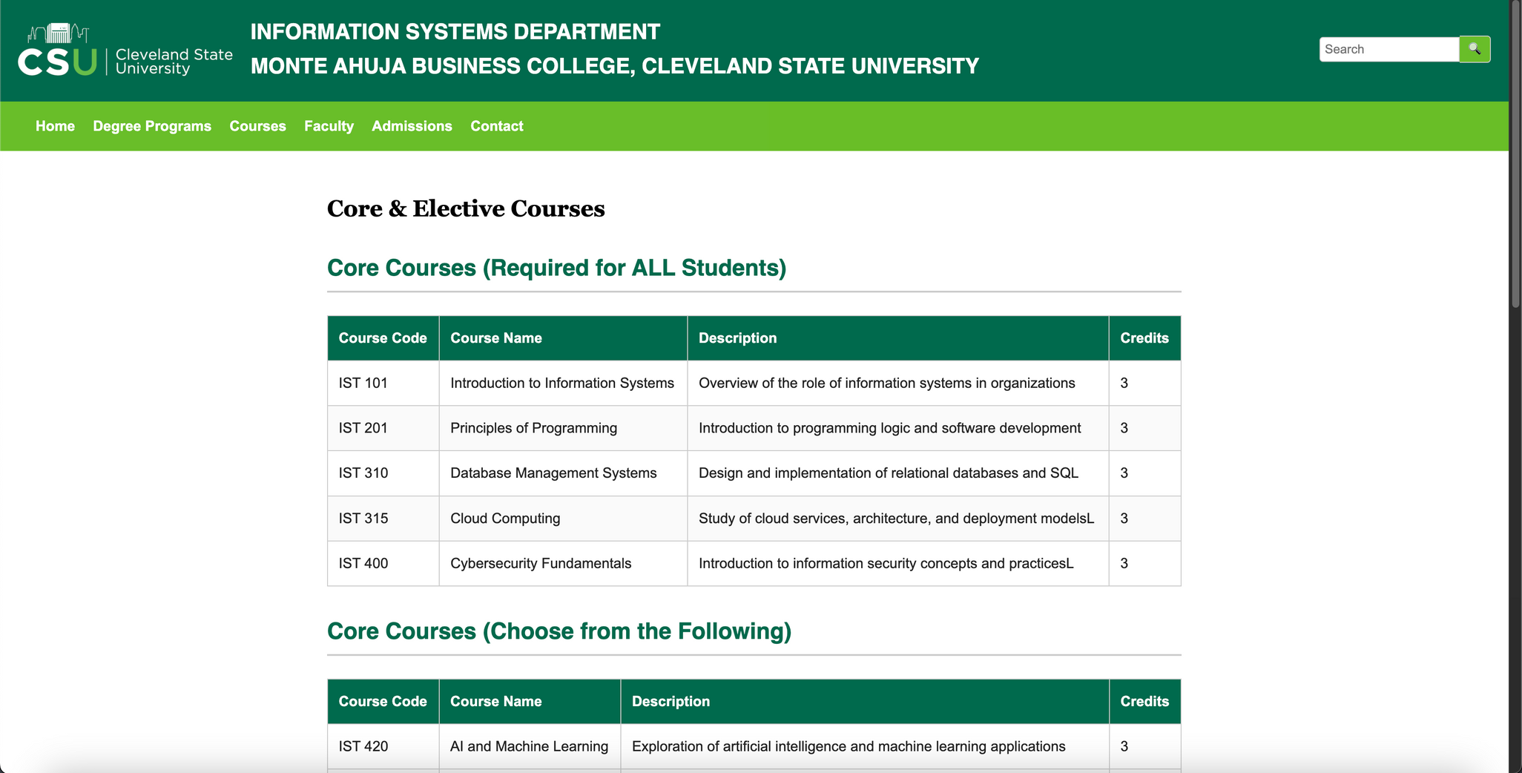
COURSES.HTML- (WEBPAGE)

Slide 14
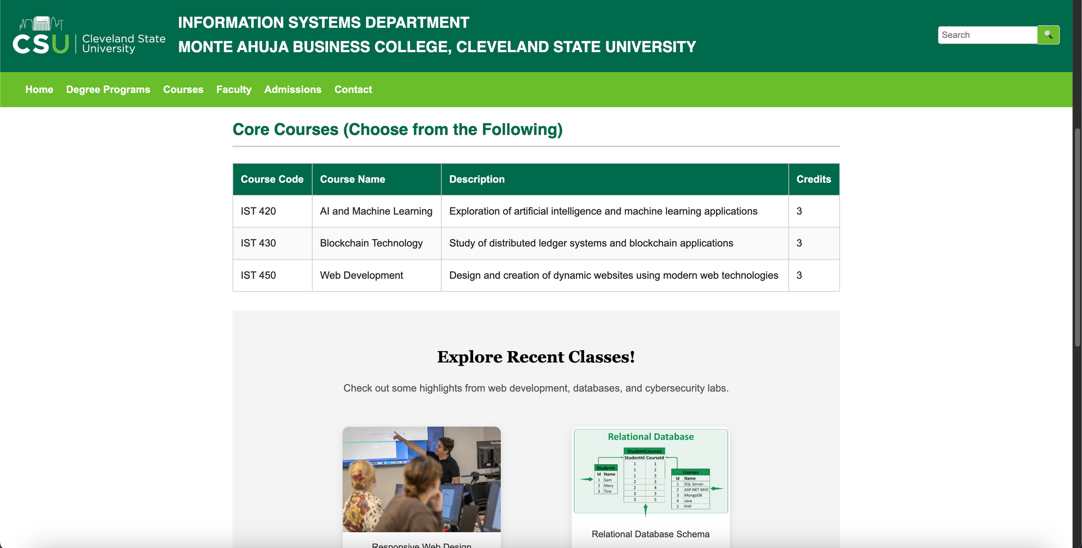
COURSES.HTML- (WEBPAGE)

Slide 15
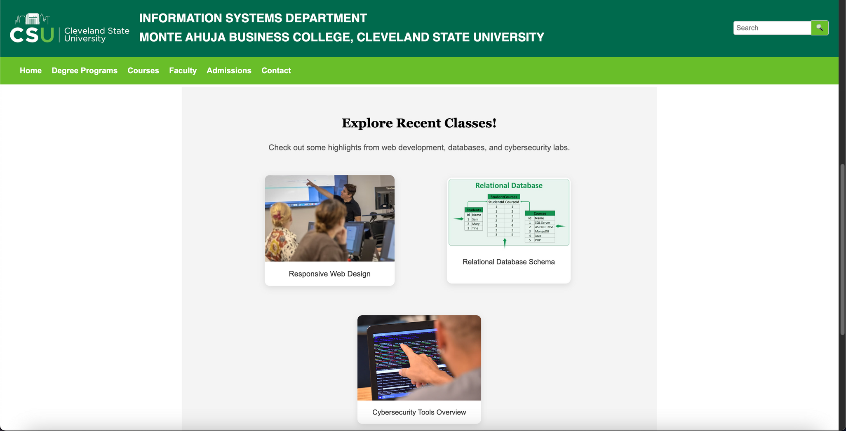
COURSES.HTML- (WEBPAGE)

Slide 16
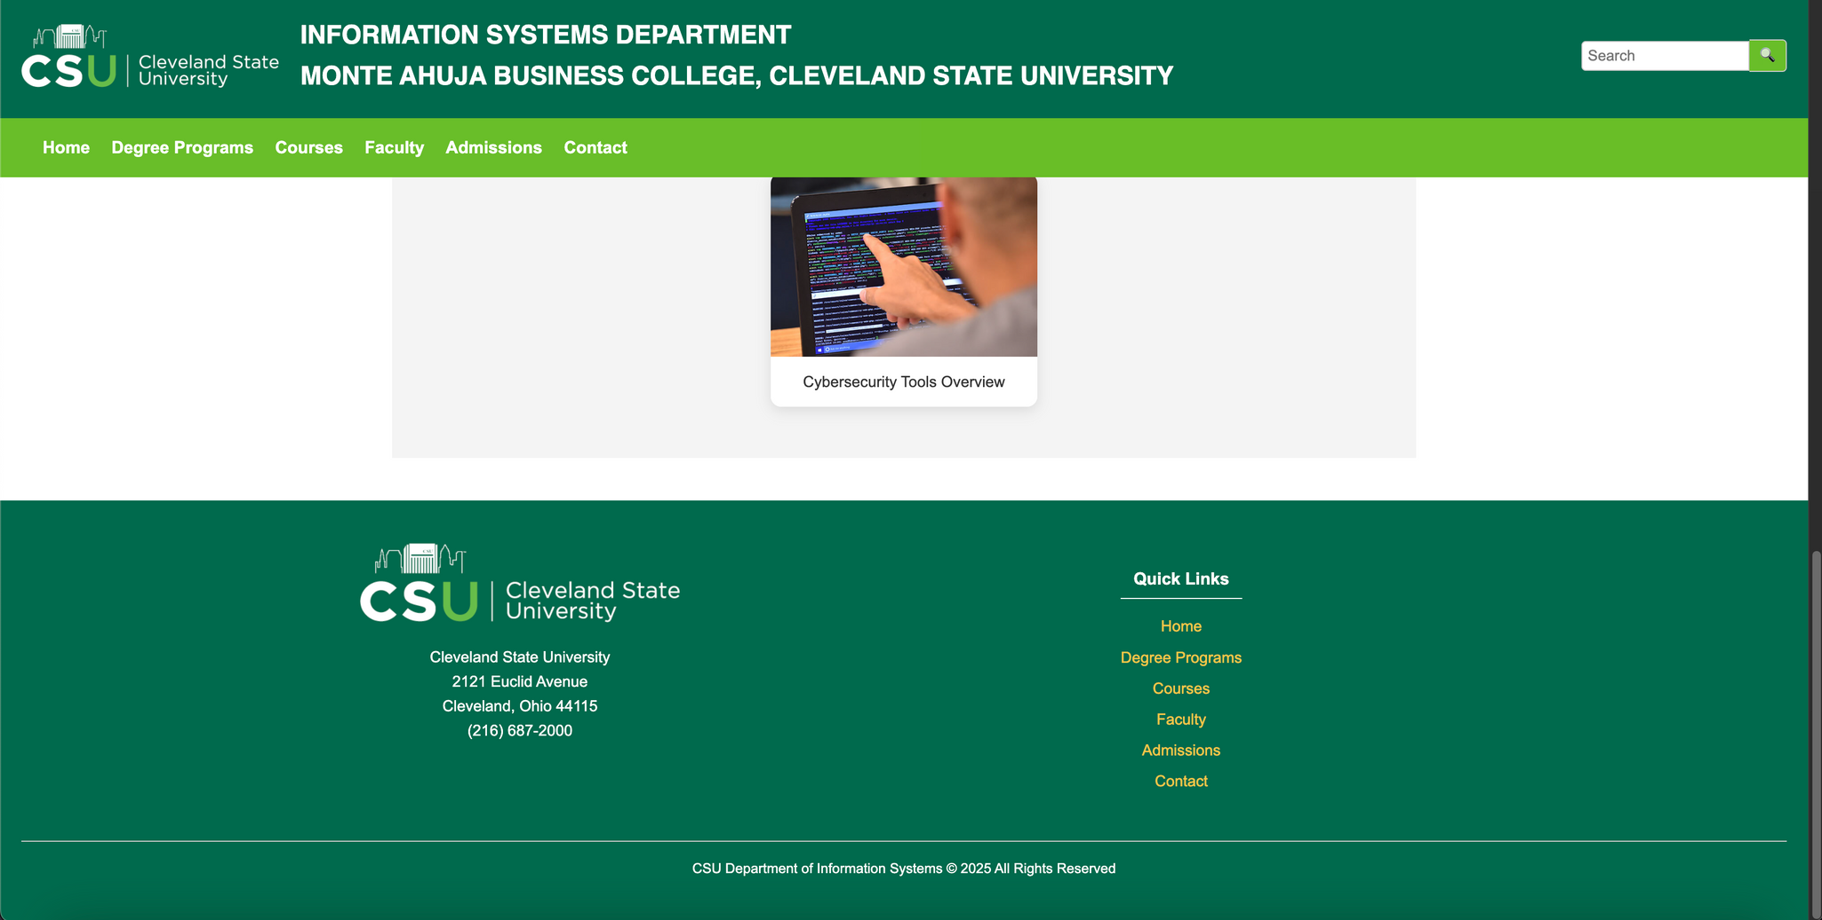
COURSES.HTML- (WEBPAGE)

Slide 17
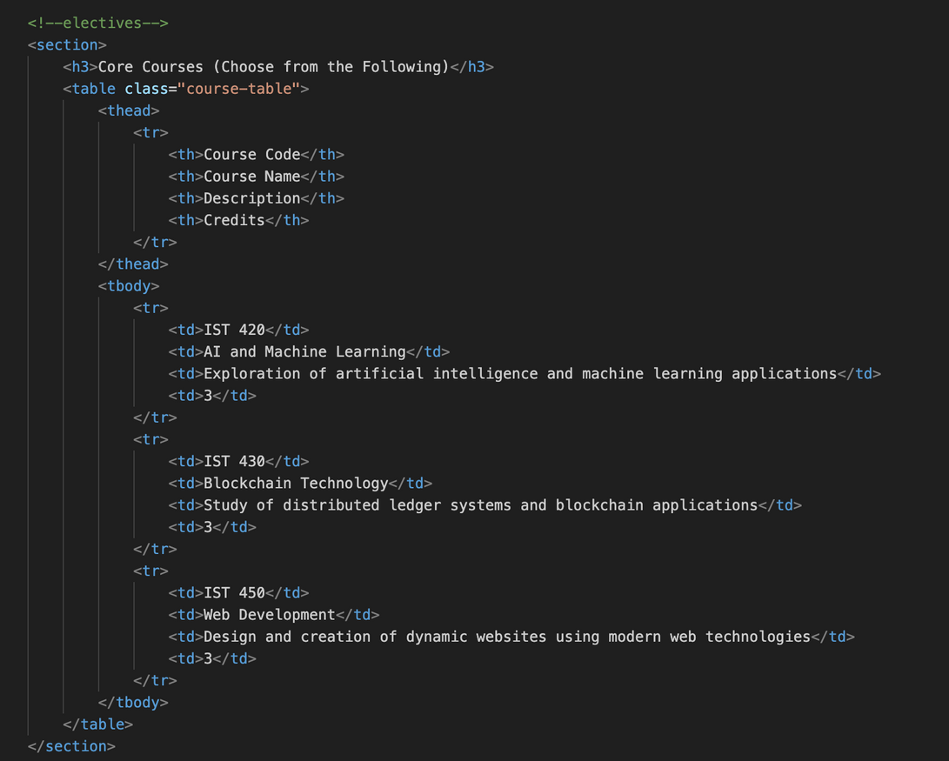
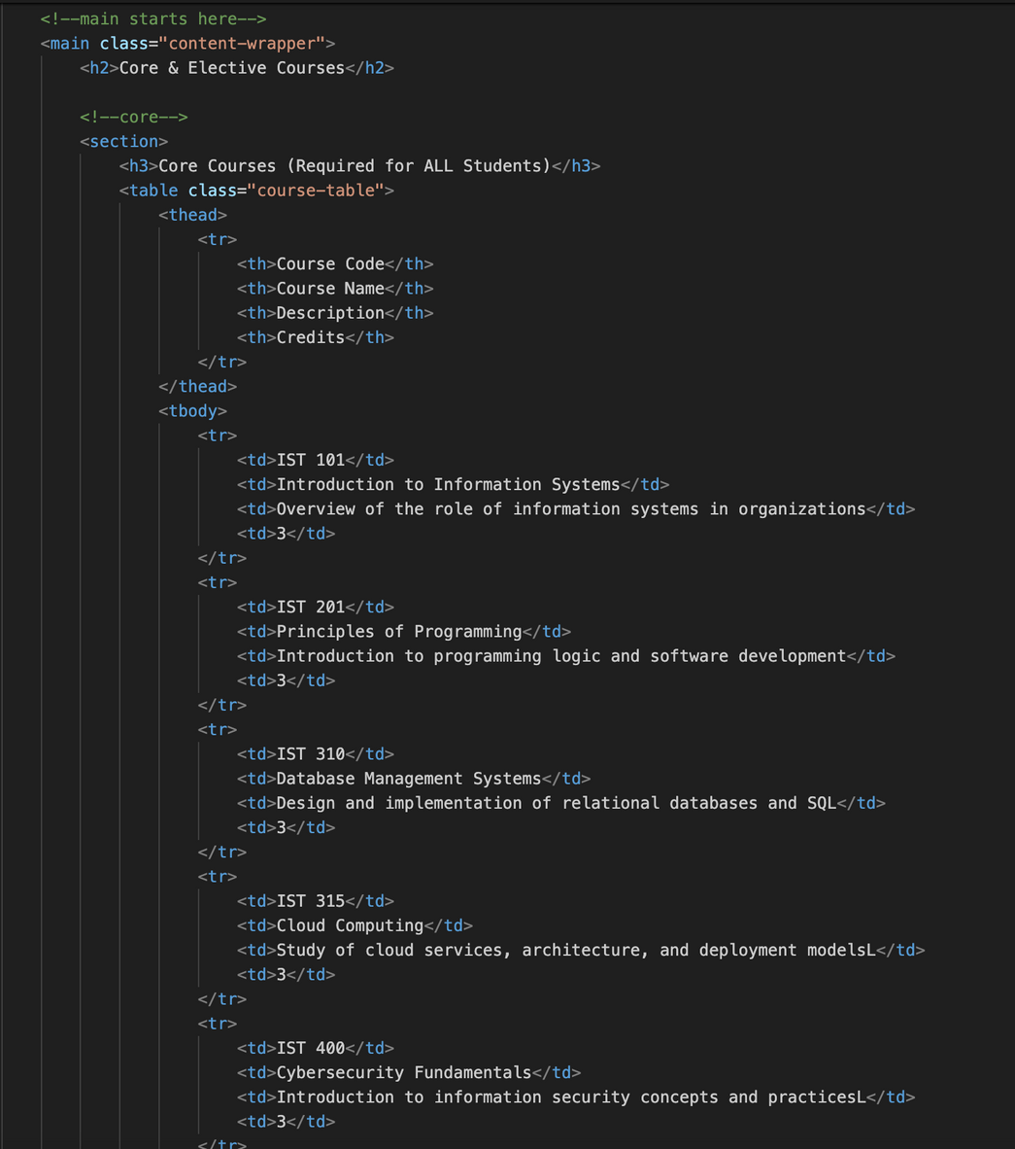
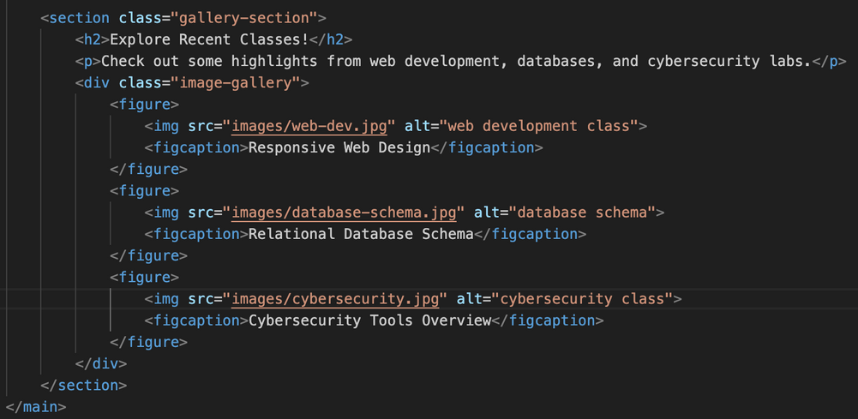
COURSES.HTML- (CODE)

Slide 18
COURSES.HTML - (CONTINUED)
Includes:
Header
Nav List
Main Content
Core and elective courses
Core table
<thead> table head, <tr> table row, with <td> table data
Electives table
Gallery section for Images of recent highlights for some classes
Shows as figures using <figure> and captions using <figcaption>
When hovered with pointer, the figures look like they’re “bouncing” out
Web development, database schemas, cybersecurity
Footer

Slide 19
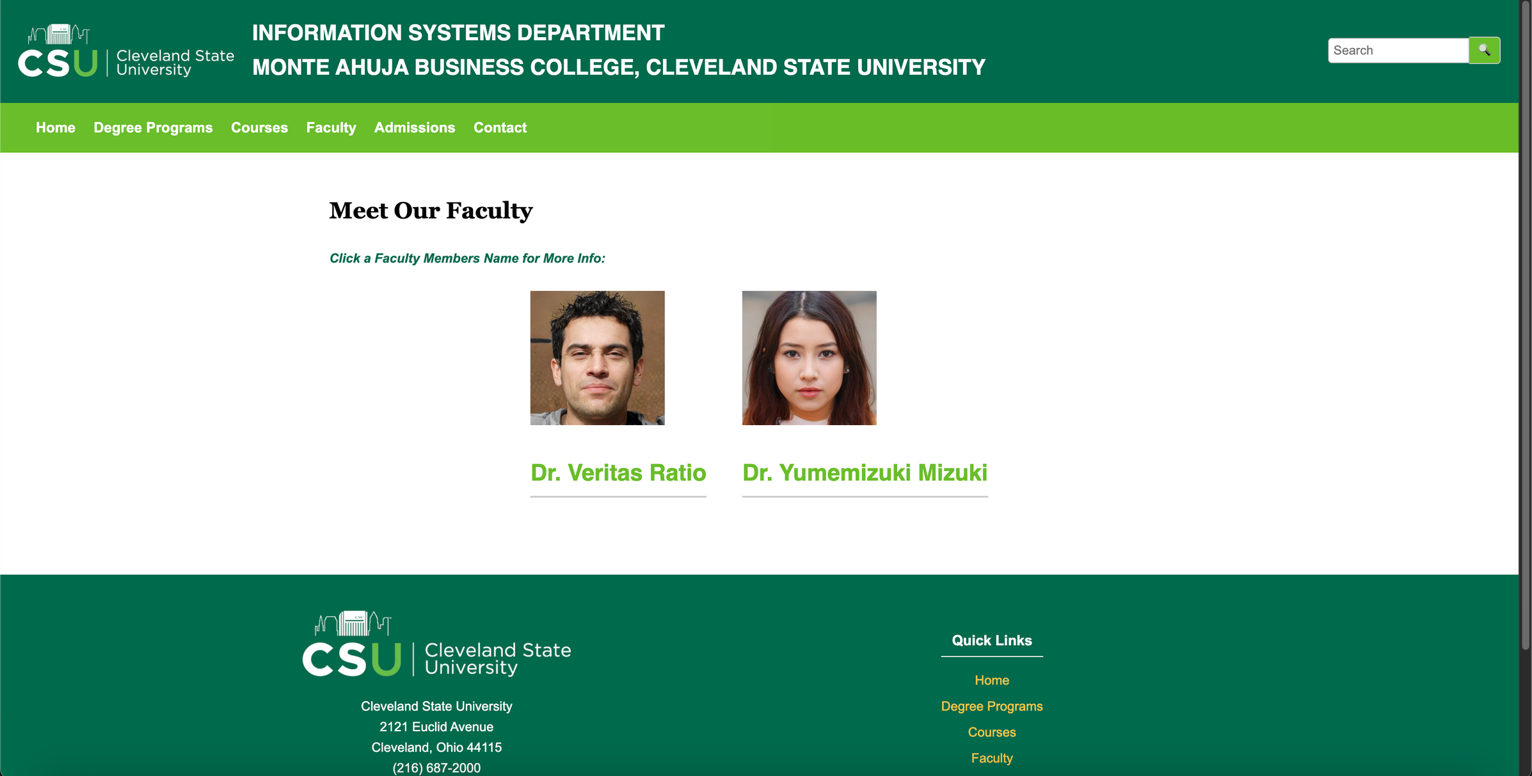
FACULTY.HTML - (WEBPAGE)
BEFORE a name is clicked on

Slide 20
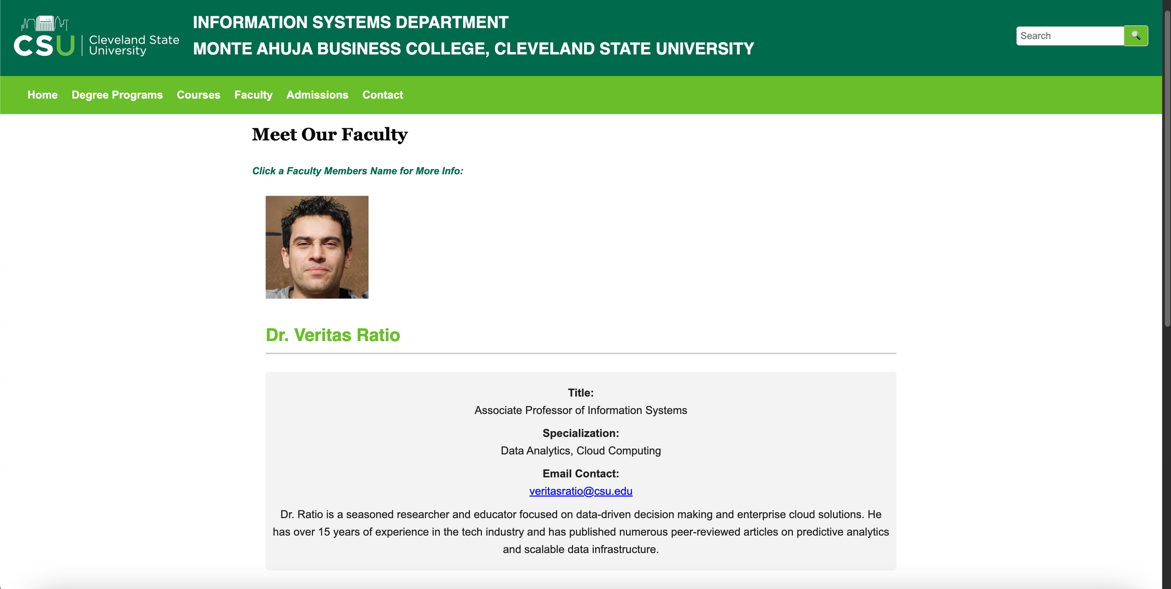
FACULTY.HTML - (WEBPAGE)
AFTER a name is clicked on

Slide 21
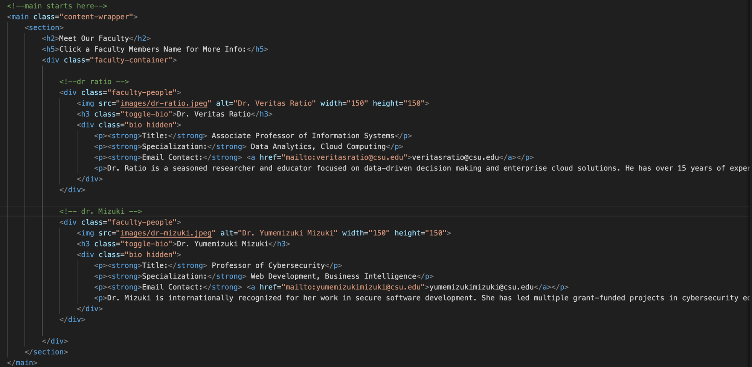
FACULTY.HTML - (CODE)

Slide 22
FACULTY.HTML - (CONTINUED)
Includes:
Header
Nav List
Main Content
“faculty-people” class
Two fake professors with profile pictures
Bios hidden until name Is clicked on “toggle-bio”
The title, specialization, email contact, and description shows up underneath the name
Email contact uses mailto:
Footer

Slide 23
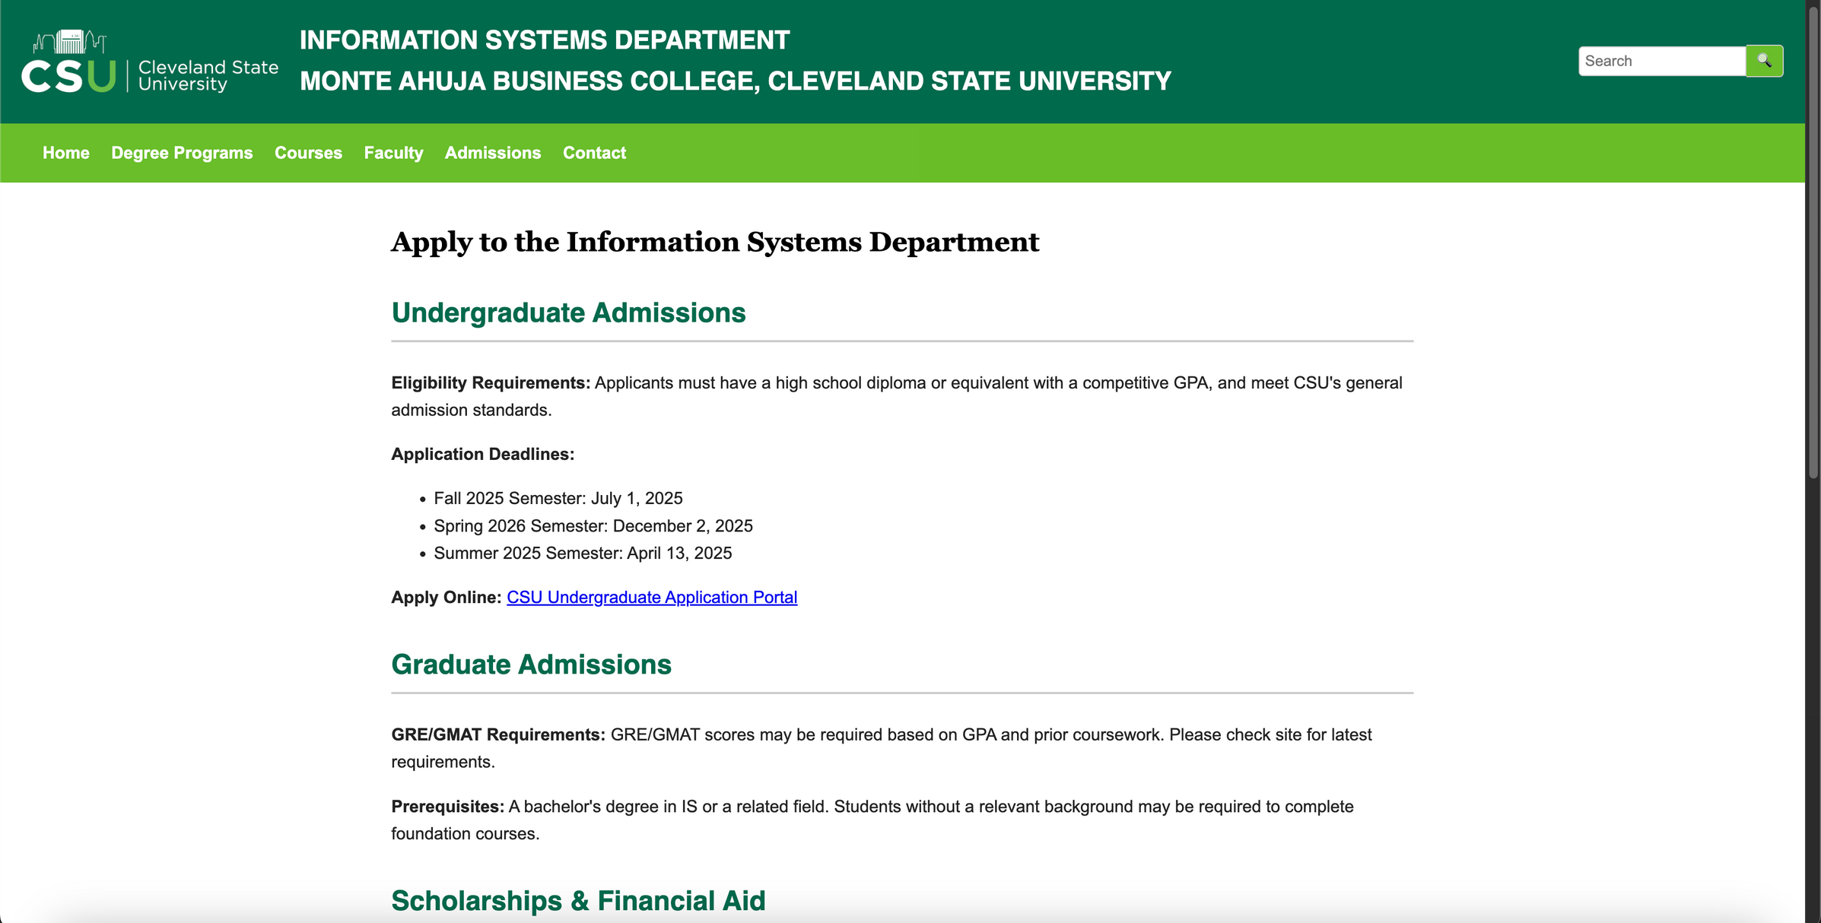
ADMISSIONS.HTML - (WEBPAGE)

Slide 24
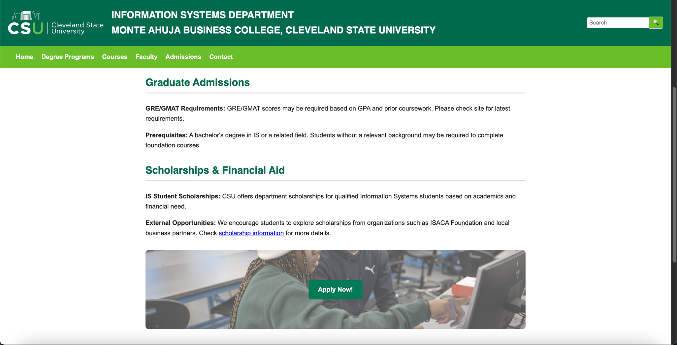

ADMISSIONS.HTML - (WEBPAGE)

Slide 25
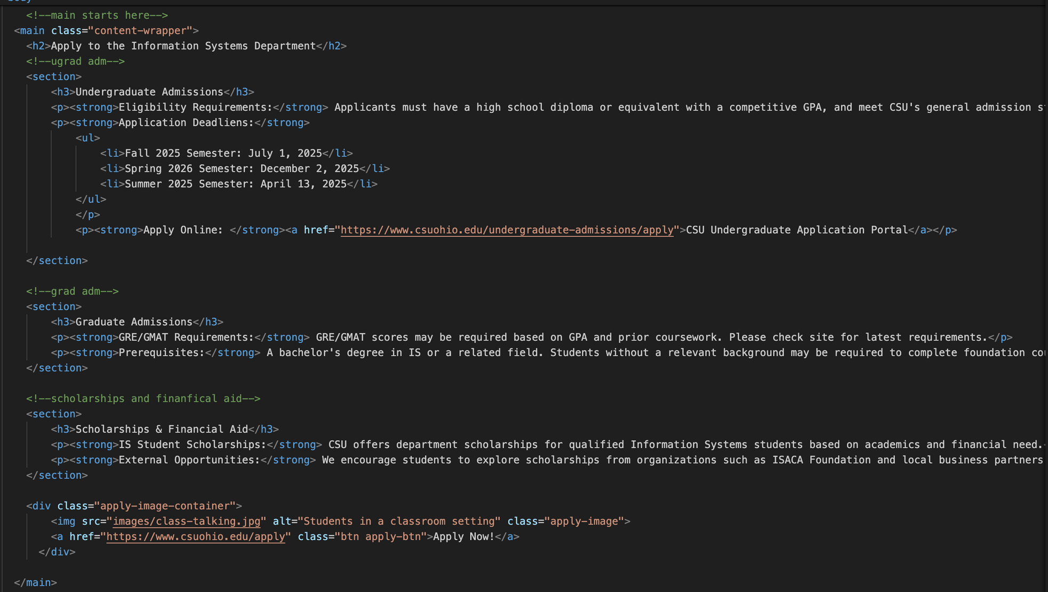
ADMISSIONS.HTML - (CODE)

Slide 26
ADMISSIONS.HTML - (CONTINUED)
Includes:
Header
Nav List
Main Content
Undergrad admissions section
Eligibility requirements, deadlines in <ul> unordered list, and link to apply online
Grad admissions section
Eligibility requirements, and prerequisites
Scholarships and financial aid section
Scholarships and opportunities Info
Image container for “Apply Now!” button
Students in a classroom setting image behind the button, lowered opactiy to be able to see button more clearly
Footer

Slide 27
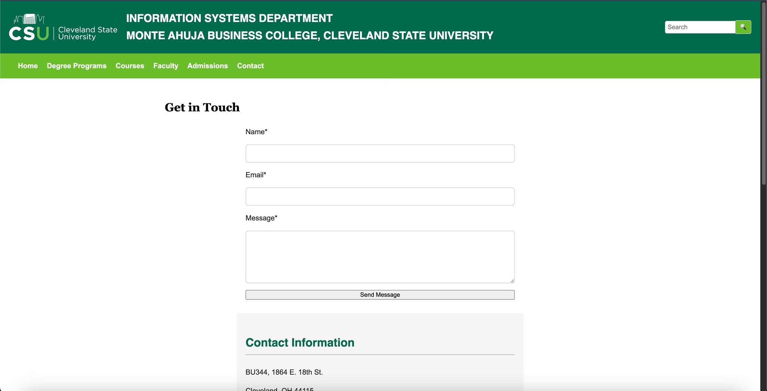
CONTACT.HTML - (WEBPAGE)

Slide 28
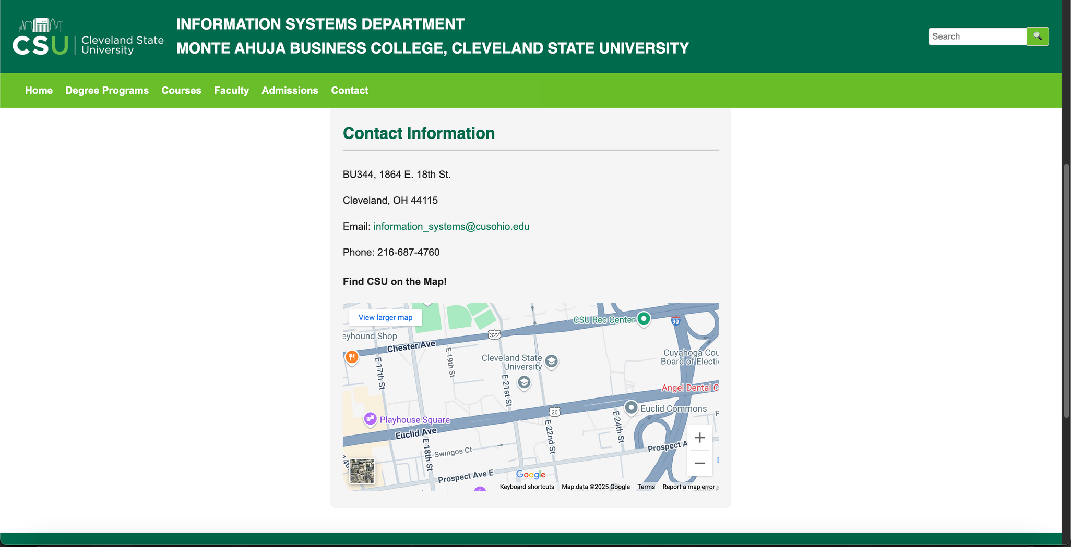
CONTACT.HTML - (WEBPAGE)

Slide 29
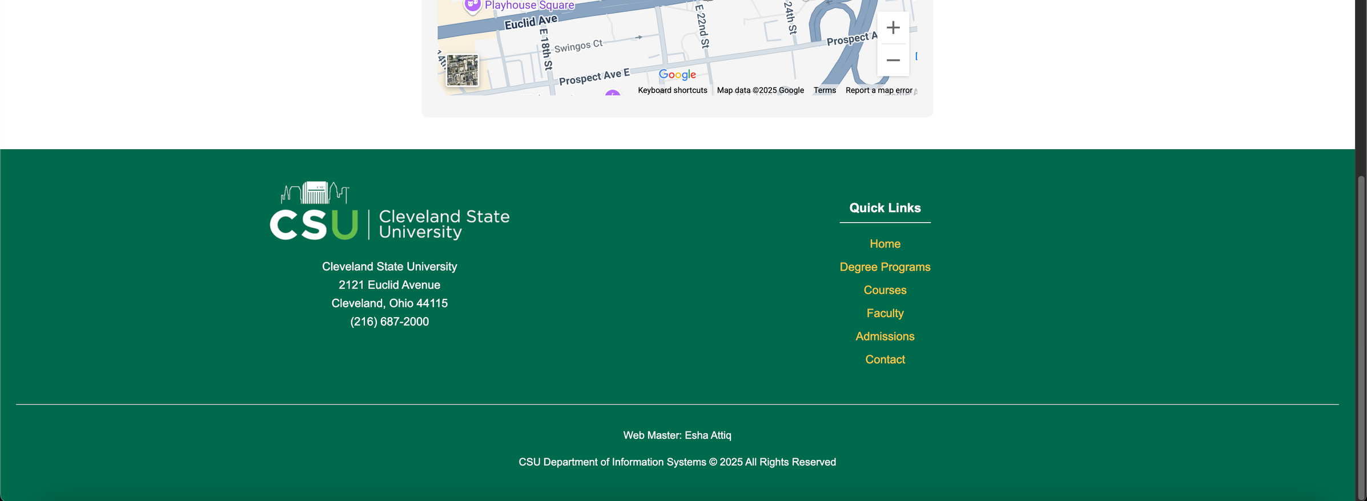
CONTACT.HTML - (WEBPAGE)

Slide 30
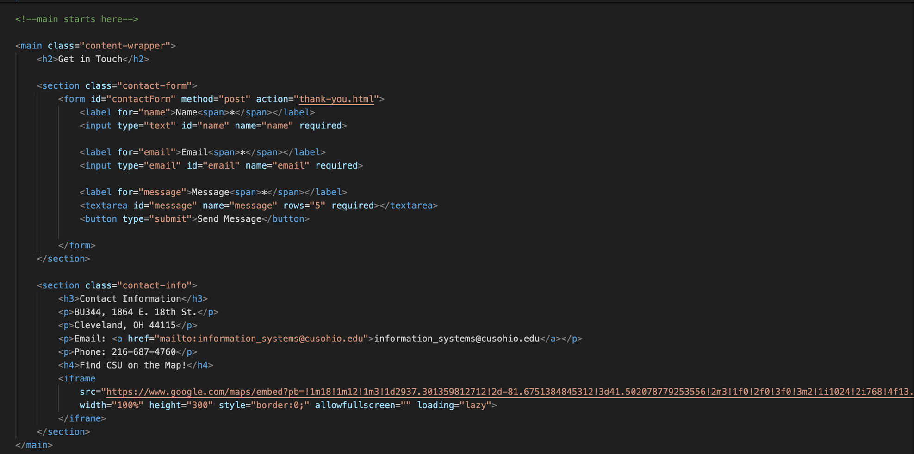
CONTACT.HTML - (CODE)

Slide 31
CONTACT.HTML - (CONTINUED)
Includes:
Header
Nav List
Main Content
“contact-form” class with post method, when submitted it redirects to “thank-you.html” page
Name, Email, and Message are all required (*) to be able to submit
“contact-info” class information about location, email, phone number
Uses <iframe> and google maps embed to view pinpoint location on site
Footer
Includes Web Master at bottom this time

Slide 32
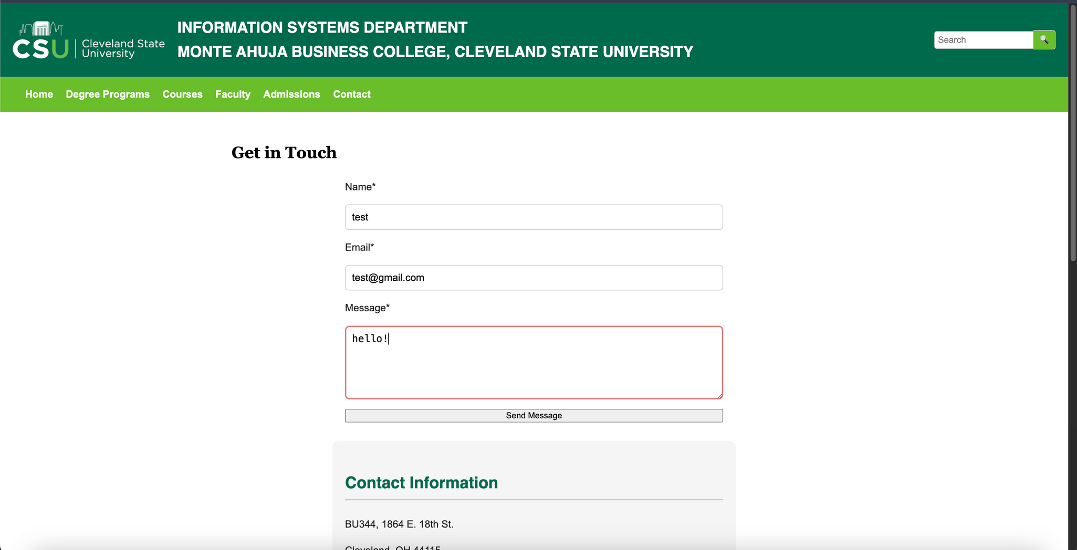
THANK-YOU.HTML - (WEBPAGE)
BEFORE submitting info

Slide 33
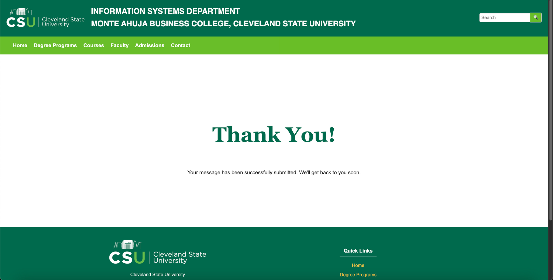
THANK-YOU.HTML - (WEBPAGE)
AFTER a submitting info

Slide 34
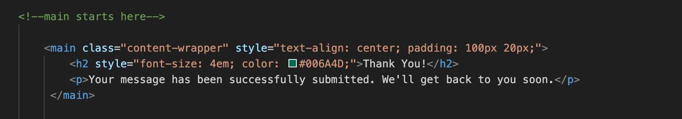
THANK-YOU.HTML - (CODE/INFO)
Includes:
Header
Nav List
Main Content
Auto redirects to this page once “Send Message” is pressed
Simple, basic page with large “Thank You!” in the center
Footer

Slide 35
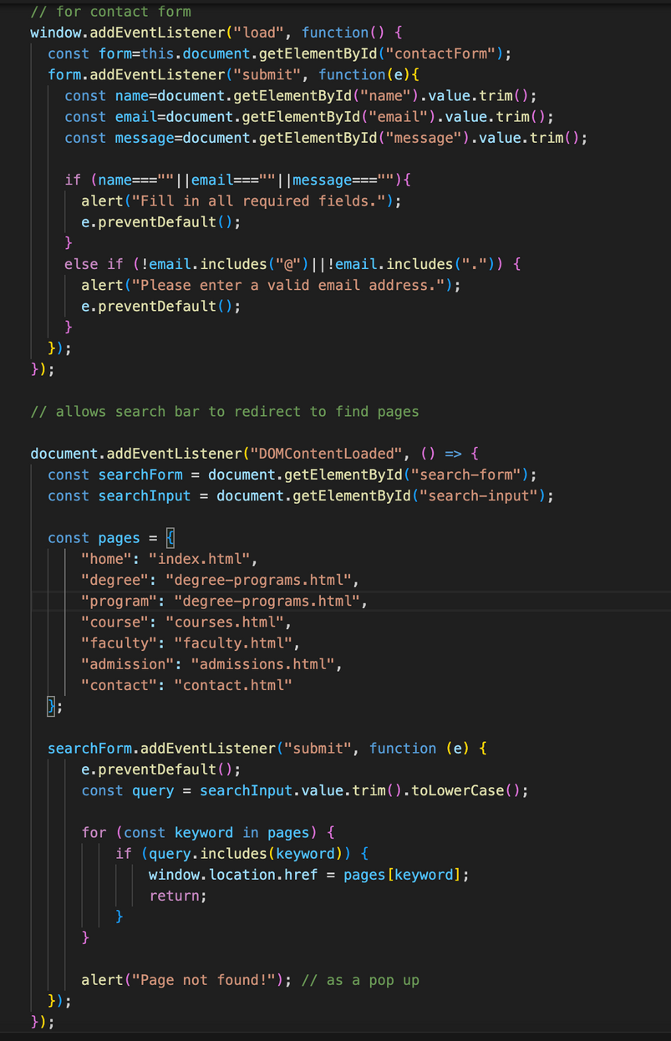
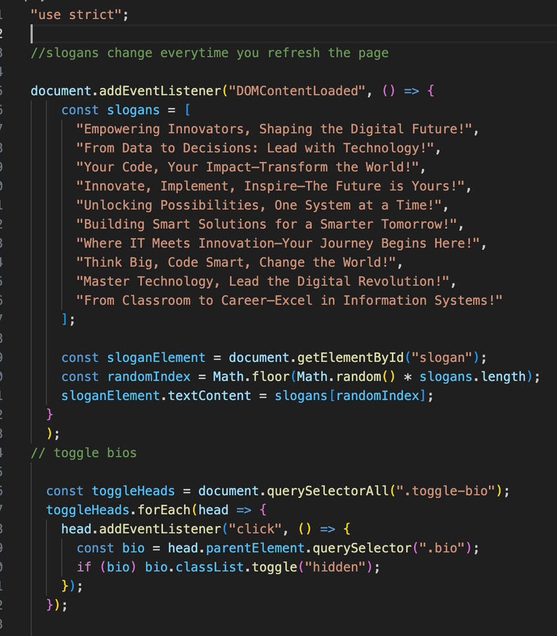
SCRIPT.JS - (CODE)

Slide 36
SCRIPT.JS- (CONTINUED)
Includes:
Strict usage
List of slogans, changes every time page Is refreshed
Toggle for bios to be able to view once “toggle-bio” class is activated/pressed
“contact-form” class, script makes sure fields are all filled, otherwise alert pops up and It prevents default
Allows search bar to redirect to page once keyword Is typed/searched In fully
If not found, alert pops up with “page not found!”

Slide 37
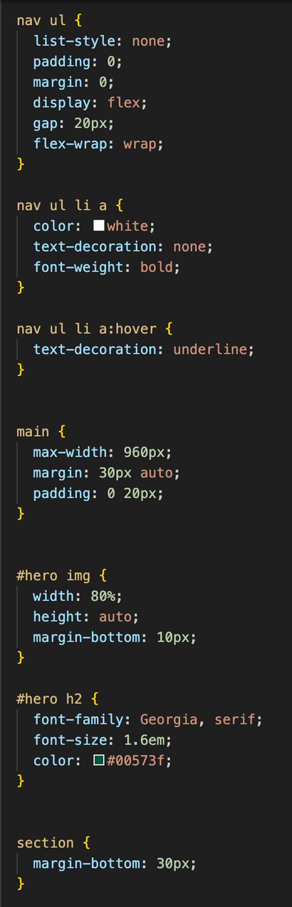
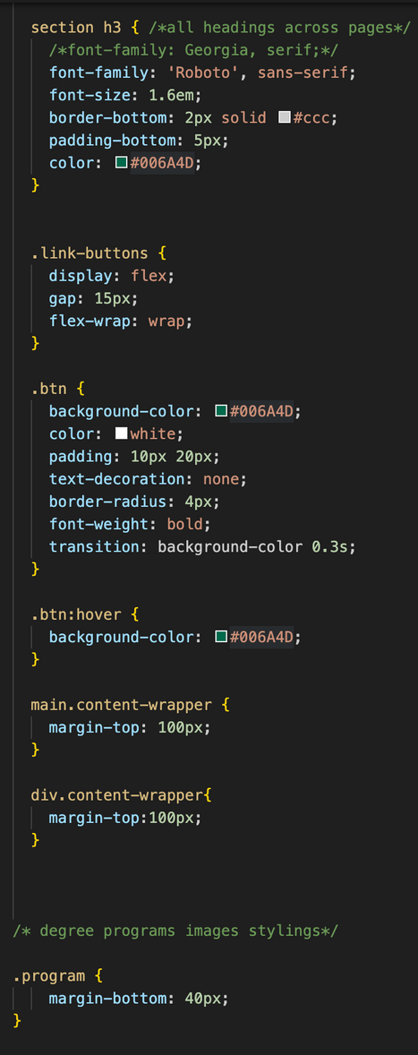
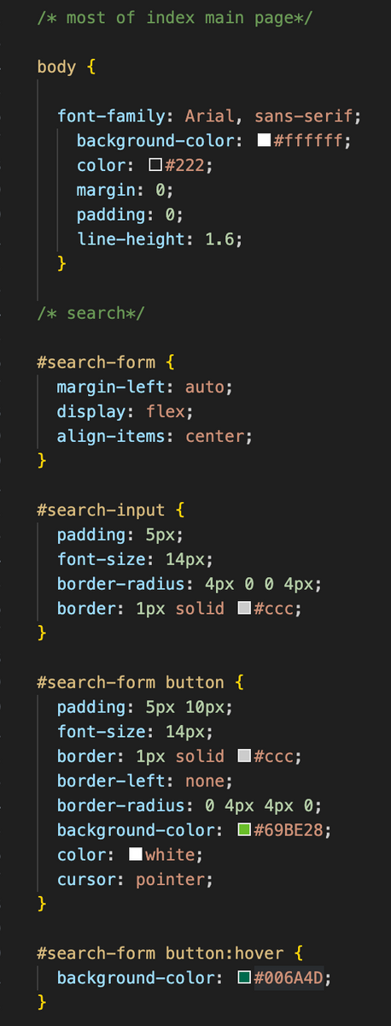
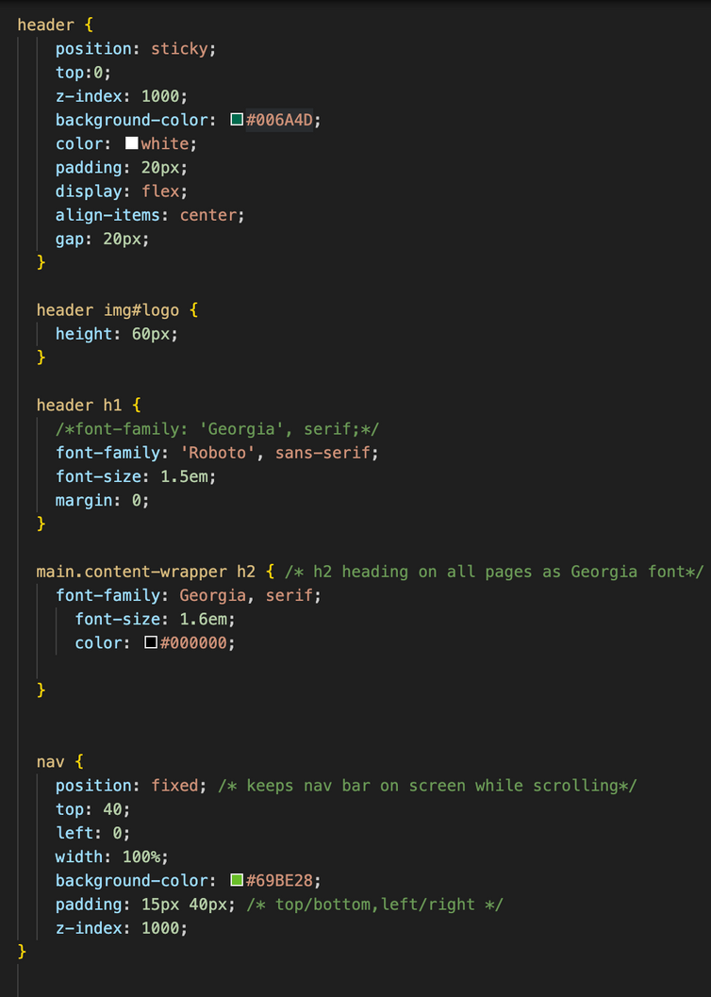
STYLES.CSS - (CODE)

Slide 38
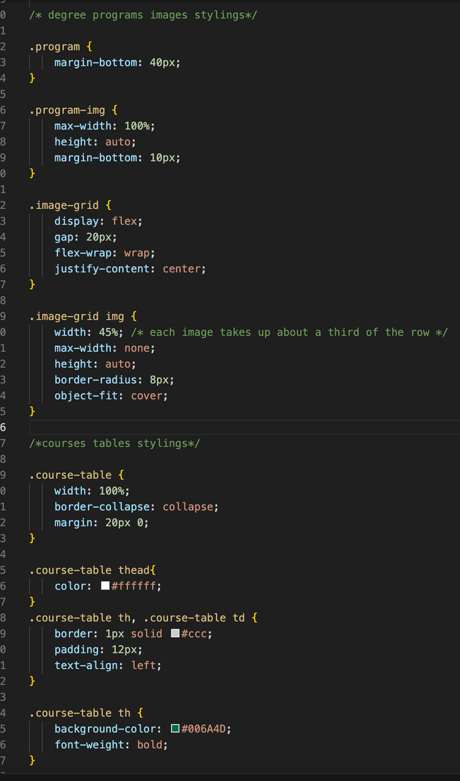
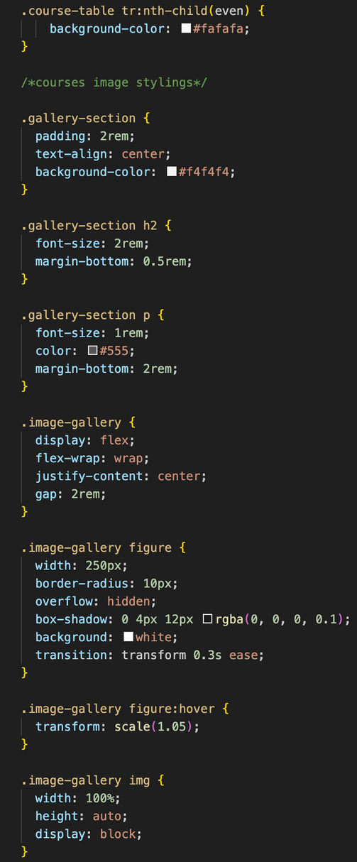
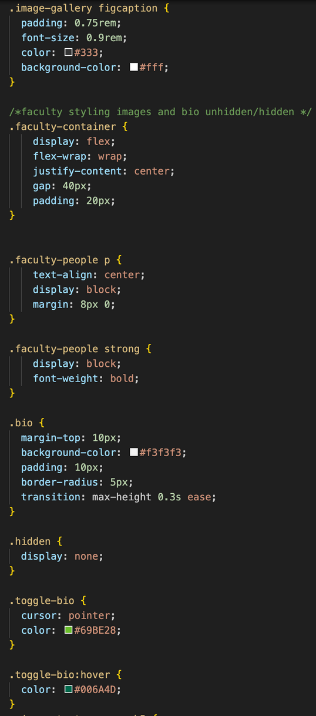
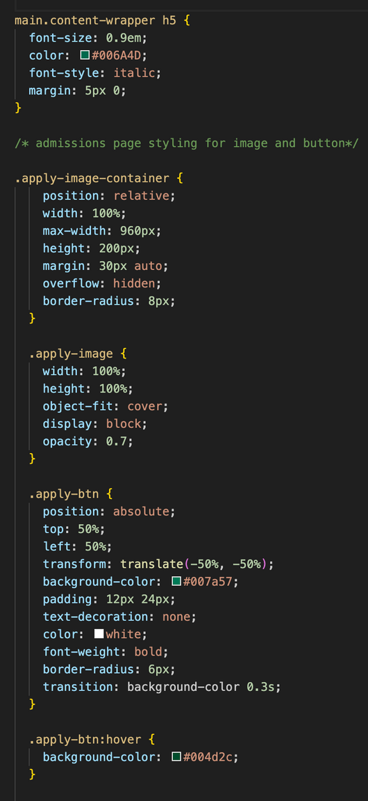
STYLES.CSS - (CODE CONTINUED)

Slide 39
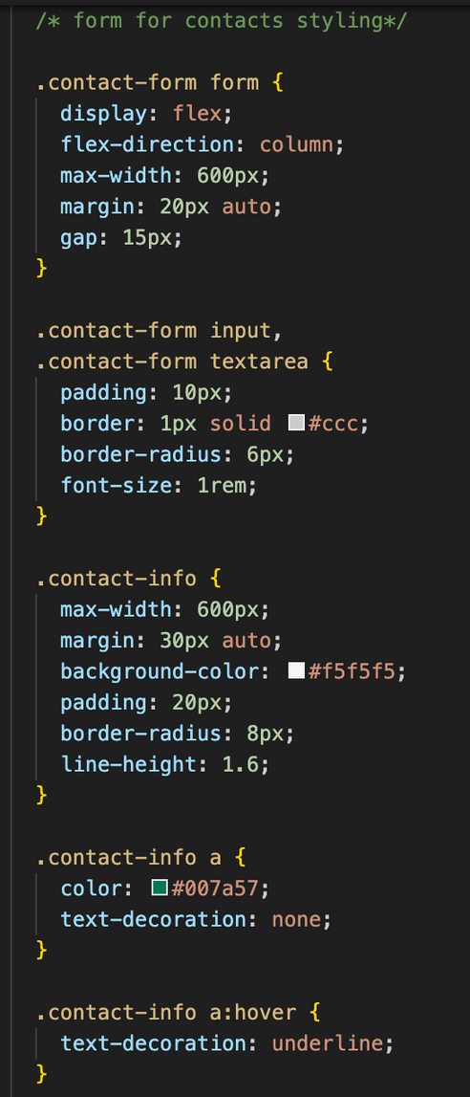
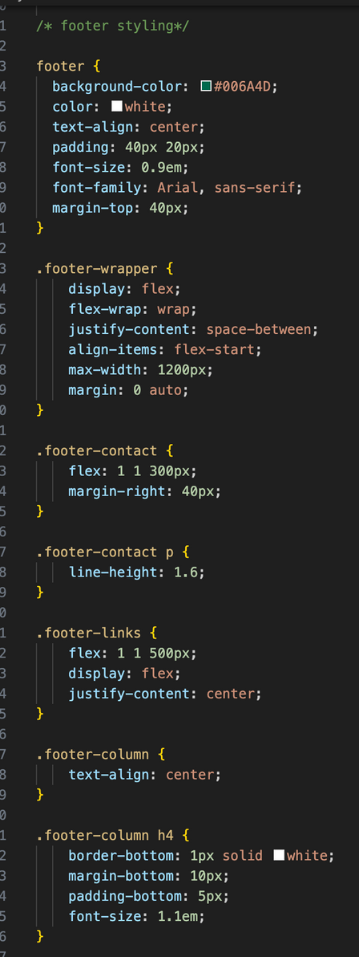
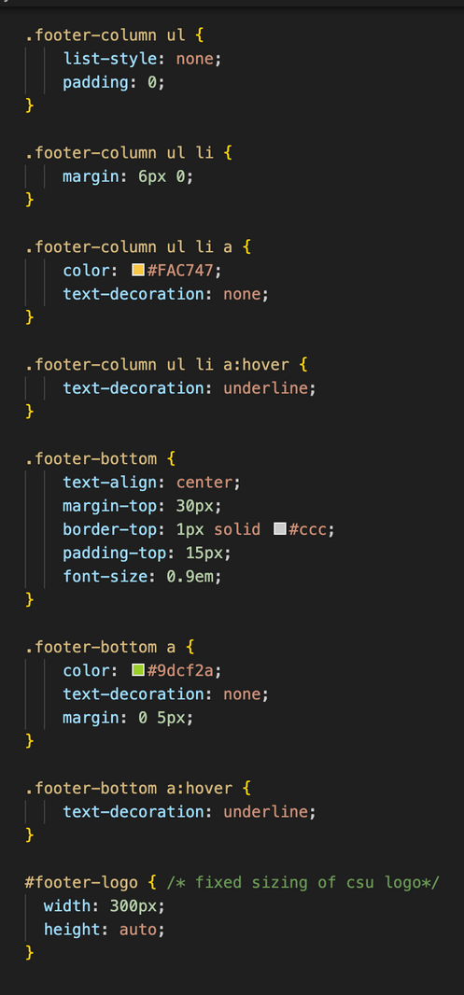
STYLES.CSS - (CODE CONTINUED)

Slide 40
STYLES.CSS- (CONTINUED)
Includes:
Comments on CSS file all split up on what is used for each page

Slide 41
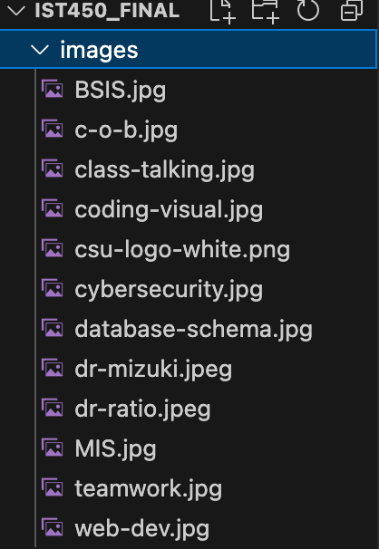


IMAGES FOLDER
Includes:
Has images used for the whole project
The path has to be “images/..” in order to use them
Each page with an image has a path like this
ex)

Slide 42
Thank you!
IST 450

